Slide 1
Memos
Interoffice memos. Paper-based interoffice memos were once the chief form of internal communication.
Today, employees use memos primarily to convey confidential information, emphasize ideas, deliver lengthy documents, or lend importance to a message.

Slide 2

Components
◆
Subject Line
❖
Opening
⬥
Body
© GEORGE FREY / BLOOMBERG NEWS / LANDOV

Closing

Slide 3
Components of Memos
◆
Subject Line
Summarize message clearly and concisely.
Avoid meaningless one-word headings, such as "Help" or "Urgent."
❖
Opening
Frontload main idea immediately.
Avoid reviewing background.

Slide 4
Components of Memos
⬥
Body
Organize information and explanations logically.
Cover just one topic.
Use numbered and bulleted lists.
Consider adding headings for visual impact.

Slide 5
Components of Memos

Closing options
End with action information, dates, and deadlines.
Summarize the message.
Provide a closing thought.
Avoid overused expressions.

Slide 6
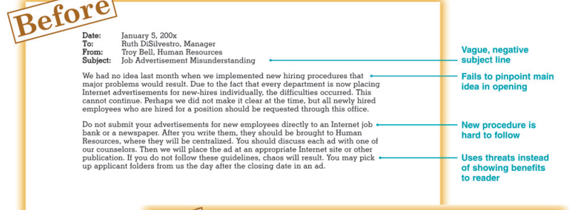
Memo, 1st draft

Slide 7
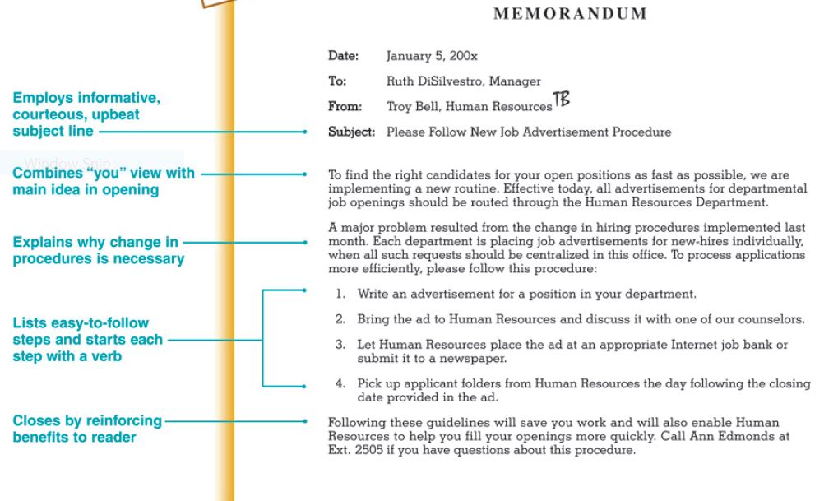
Revised Memo

Slide 8
Using Memo Smartly, Safely, and Professionally
Content, Tone, Correctness
Be concise.
Don’t send anything you wouldn’t want published.
Care about correctness and tone.
Resist humor and rage.

Slide 9
Writing Plan for Memos
Subject line: Summarize the content of the message.
Opening: Expand the subject line by stating the main idea concisely in a full sentence.
Body: Provide background data and explain the main idea. Consider using lists, bullets, or headings to improve readability.
Closing: Request a specific action, summarize the message, or present a closing thought. If appropriate, include a deadline and a reason.

Slide 10
Writing Memos
Create goodwill by being respectful
Demanding: Submit your answer within one week.
Respectful:
Show “you” attitude by being positive and tactful
Negative:
Your complaint about our fees is way off target. They are definitely not higher than those of our competitors.
Tactful:

Slide 11
Writing Memos (cont.)
Emphasize reader’s needs and benefits
Weak: We must receive the sales receipt before we can
process the refund.
Improved:
Use modest tone
Arrogant: My attached report is very thorough, and I am
sure you will be impressed.
Modest:

Slide 12
Characteristics of
Effective Memos
Civilized: use courtesy and tact
Concise: condense information
Coherent: use clear and logical structure
Compelling: use persuasive diction
Correct: follow conventions of quality writing

